Slide 1

HackMerced
Bringing technological innovation to the heart of the San Joaquin Valley since 2016.
Notes:
Hello, and welcome to HackMerced. Merced is in such a valuable position for California: We hope HackMerced builds towards a culture of designing disruptive innovations, challenging the norm, and creating cool things. But for many of you, a hackathon might be a new concept. How many of you guys are new to the hacking community?
…

Slide 2

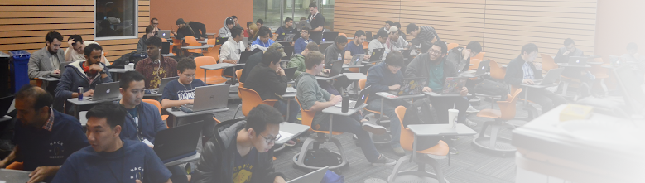
What is a Hack?
a quick solution that solves a problem, but does not solve it particularly well, or in a particularly efficient way
Hackathons are for:
Learning new skills
Realizing the roles you can play in your field
Identifying and tackling big problems
Notes:
I want to welcome you. For me, this community has been so important. The hacker community is one of constant innovation and is also incredibly welcoming. But what is a hack?! A hack is something slapped together in 36 hours that attempts to tackle a real world problem. For you computer science nerds out there, we aren’t concerned about your Big O run-time of your algorithm or how many lines of CSS it takes to make your website look presentable, we mainly care about your idea, your willingness to innovate and try new things, and what steps you took to tackle a problem that is important to you.
Hackathons are an event for personal and professional development: For example, learning a new skill. Maybe you’ve never took the time to figure out how to make a website or learn a new language. This is the perfect environment to do that. We have mentors for all levels of hackers, and we love to see people pushing themselves to learn new skillsets. It’s also important in realizing what real-world roles you can play with your major and experiences. For example, if you are the only always leading group projects in classes, you might find yourself excelling in project management in a hackathon or real-world environment. Or if you like crunching big sets of data, you might realize being a data scientist is appealing to you. And lastly, hacks target and attempt to solve big problems. What sort of problems? Really anything, but we’ll talk in a few minutes about the sort of categories HackMerced is excited to innovate within.

Slide 3
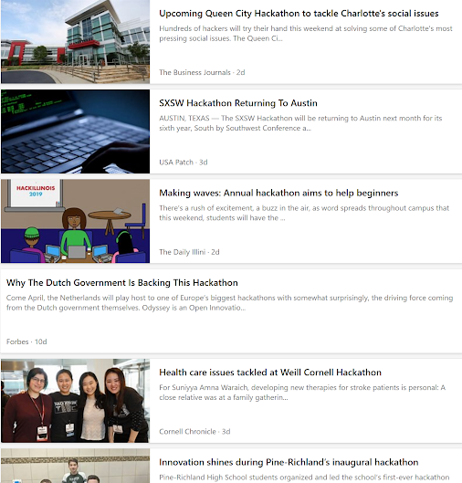
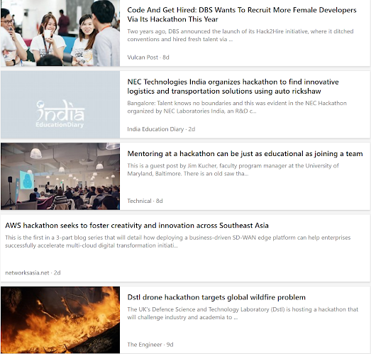
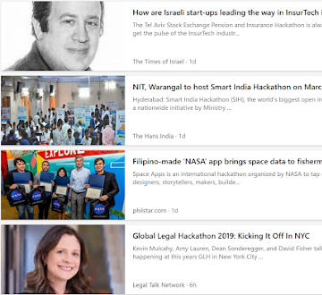
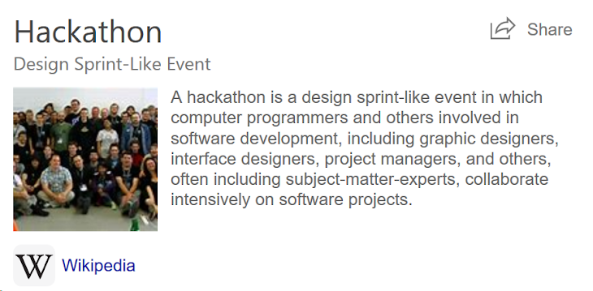
Notes:
Hackathons have become a sort of cultural foundation for the tech community. I went ahead and searched “hackathon” on Google and grabbed the first things that popped up: “”
“”
“”
“”
Some of you might be like “Cool, but what IS a hackathon”. Well, that’s what wikipedia is for:: It’s a short event where computer sciences, subject matter experts, and others come together to collaborate intensively. The take-aways here? Don’t have to be CS, isn’t a one-man thing, work in teams, and its pretty fast paced. 36 hours might seem like a lot, but it goes by fast! Because of this, we don’t expect polished products, or even products that work necessarily. Rather, we are excited to see what sort of innovative applications of technologies you guys can think of, tinker with, and build this weekend. I hope that gives a good idea of what we at HackMerced try to do. I’d like to turn it over briefly to the guy who made this event possible, founding HackMerced ~3 years ago, Deo Halili.

Slide 4
Deo Halili
Founder @ HackMerced
Notes:
oof

Slide 5
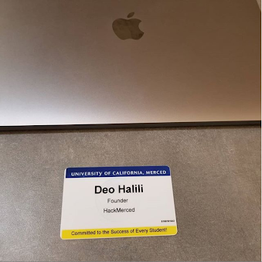
Notes:
Hello everyone,
my name is deo halili and I guess I'm the founder of Hack Merced.

Slide 6
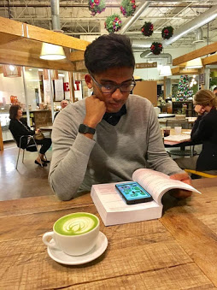
Notes:
I definitely did not do it alone though, shubham naik, who is not in the audience did a lot of the heavy lifting.

Slide 7
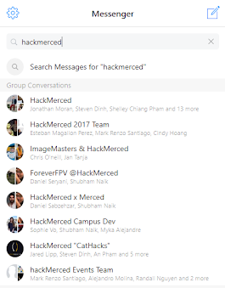
Notes:
we also had a dedicated team of leads, 50+ hard working volunteers, supportive sponsors and some great vendor relations.

Slide 8
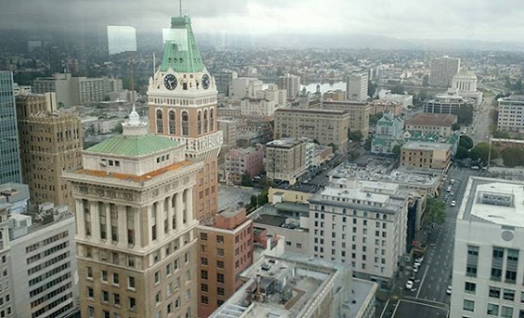
Notes:
but yeah starting hack merced took the better part of 2 or 3 years of my life

Slide 9
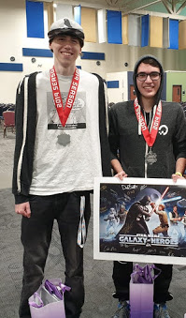
Notes:
so to be honest, i'm really happy that three years later you're all here attending the fourth iteration of this event ran by people that (expound upon)

Slide 10
Vets - fans - n00bs
Notes:
okay, who here has been to a hackathon before? raise your hand, cool cool. put em down
who here has been to hack merced before? raise your hand, awesome glad ya'll came back
now who here is at their very first hackathon? hm wow
do you have any idea what you're in for?

Slide 11
definition
Notes:
okay high-level
hackathons are x-hour long coding competitions, where the event throwers aka the team, provides you the hackers a space, swagg, free food, and hopefully stable wifi. where you can build "whatever you want". at the end you present your work and hopefully win some prizes.

Slide 12
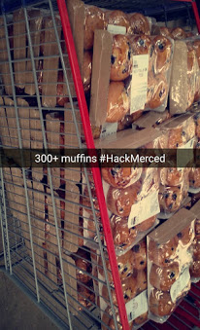
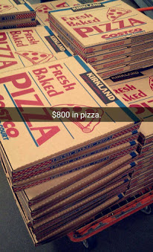
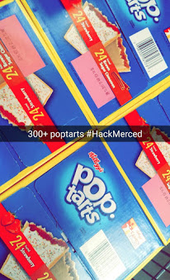
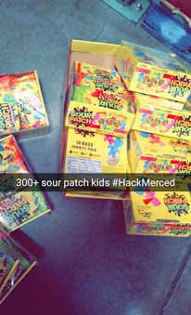
Notes:
okay pretty high level. so why are you here? maybe to win prizes, free food is always great in college, i have way too many free shirts from these events.

Slide 13
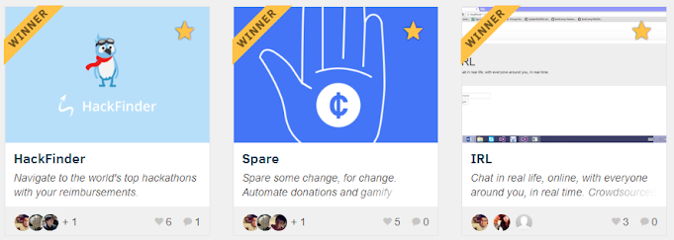
Notes:
honestly networking is pretty good, maybe you can land an internship, maybe you do something really cool and add it to your resume.
but for me at least you can get so much more

Slide 14
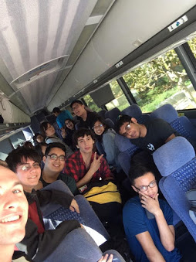
Notes:
you can meet one of your best friends on a bus ride to san diego, you may pass out in a hallway, unfortunately spill dr pepper on your mac

Slide 15
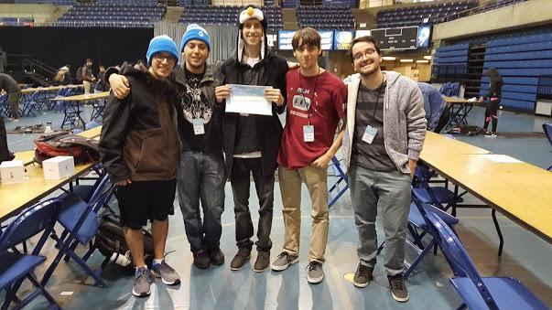
Notes:
maybe you continue to work with these people at these events

Slide 16
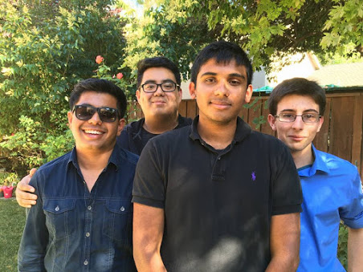
Notes:
maybe you start a company with the people you work with

Slide 17
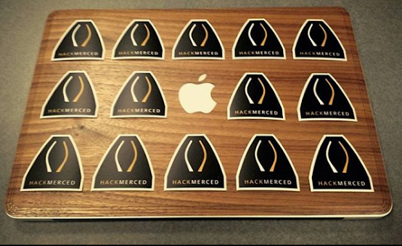
Notes:
who knows you can end up with countless stories that you never really get tired of telling, idk
but yeah it's a lot
i hope you have a lot of fun, i hope you do well
your organizers have worked really hard to throw this event
anyways i wouldnt be me if i wasnt competitive and this is a hackathon so if you want help, there are definitely mentors

Slide 18
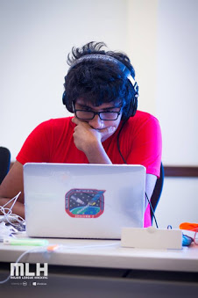
Notes:
definitely dont ask me how to code, unsure how i got a degree in cs, but id reach out to shubham naik if you have any technical questions
if you want help with your: idea, pitch, or whatever feel free to reach out

Slide 19
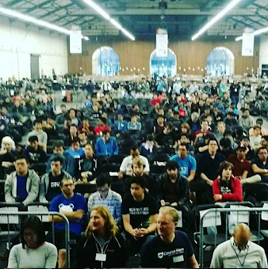
Notes:
i want to see you all do well
have a great time

Slide 20
Tracks
a.k.a Areas of Interest
Notes:
Thanks Deo, And I welcome you guys to bother him during the event if you have any questions. Anyways, I’d like to talk about what HackMerced is excited to see in the next 36 hours:

Slide 21


Social Good
developing hardware or software that support healthy, sustainable, connected, and equitable livelihoods in the United States and abroad
Check out citris.ucmerced.edu/initiatives!
Prizes
First Place: 4 x Amazon Fire HD Tablets
Runner Up: $25 Amazon Gift Cards for each team member.
Notes:
First, thanks to our sponsorship with the Center for Information Technology Research in the Interest of Society (CITRIS), one of our three main-track events will be hacks for social good. We’d love to see hardware/software that supports health, sustainability, connectedness, and equitability. I’d recommend checking CITRIS out at citris.ucmerced.edu/initiatives for what big problems CITRIS is trying to tackle. Prizes:

Slide 22

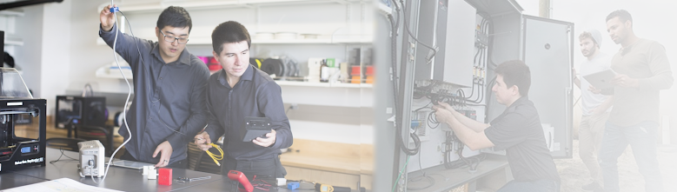
Entrepreneurship
the process of designing, launching and running a new business: liberate what you innovate
Saturday 6:00 pm: meet with entrepreneurs.
Prizes
First Place: 4 x ENACFIRE E18 Wireless Earbuds
Runner Up: $25 Amazon Gift Cards for each team member.
Notes:
The second track, sponsored by the UC Merced Venture Lab, is our Entrepreneurship track. For those who don’t know, the Venture Lab is a startup incubator to help students take their ideas from concept to I’m excited to partner with the Venture Lab

Slide 23

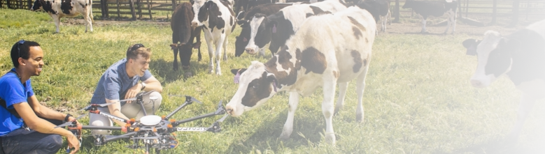
AgFoodTech
“transforming the global food system” through digital technologies, informatics, robotics, and machine-learning
Prizes
First Place: 4 x SIMREX X300C Camera-equipped drones
Runner Up: $25 Amazon Gift Cards for each team member.

Slide 24
Matthew Lange, Ph.D.
Food Science & Technology, UC Davis

Slide 25
Sponsor Challenges
More ways to win!

Slide 26
CSxA
CS can be used to express your inner-self in the same way drawing or painting can.
This award is for projects that aren’t all about making money or solving a problem in a kernel, but about using code to make something awesome.
Some Examples
An interactive web based video game
A VR sculpture
Arduino boards that lets you play music
Prize
$250 for your team or for a charity of your choice

Slide 27

Best Beginner Hack
Hackathons are about getting people engaged with technology. We want to recognize those taking their first steps into the world of hacking.
If 50% or more of your team is new to hacking, anything you do is eligible for this prize!
Some Examples
Designing an HTML website
Making an Arduino alarm clock
Deploying a mobile application
Prize
Makey Makey Classic Kits

Slide 28

Best Game
Games are arguably the most immersive form of entertainment media. Their social and cultural influence can be seen across all levels of society.
Whether it is a unique art style or complex technical gameplay, we look for games that add one’s personal flair to the art form.
Prizes
2 x MM830 Mice
2 x MK730 Keyboards
4 x MH703 Earbuds

Slide 29

Best Use of Social Media API
Social media plays a huge role in our daily lives. It allows us to connect with one another, tell stories, or market and sell products.
How can you use a Social Media API (Facebook, Twitter, Instagram, LinkedIn) in the most creative way possible?
Some Examples
using Facebook profiles to create user profiles on your application
using data from Twitter to graph the hottest trending topics
using data from Instagram to find popular places/brands filtered by category (hottest trending Steakhouse, hottest trending sneaker brand, etc)
Prize
4 x LUXCOMS RGB Gaming Mouse Pads

Slide 30


Slide 31


Slide 32
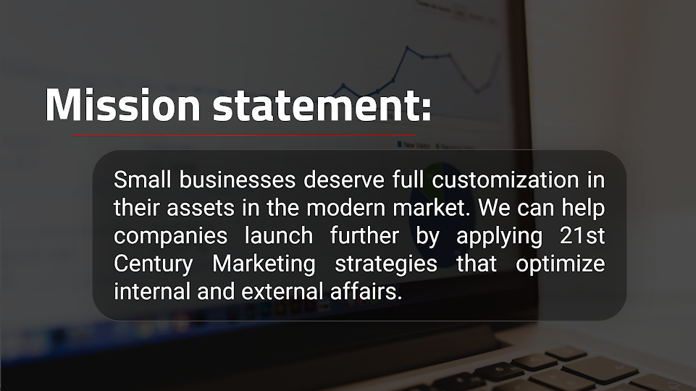

Slide 33
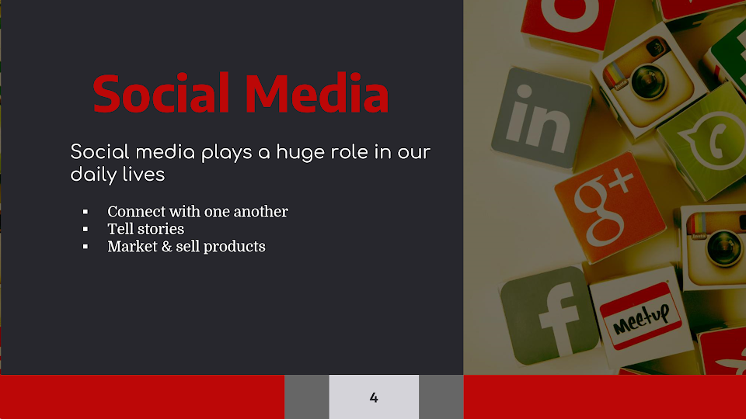

Slide 34
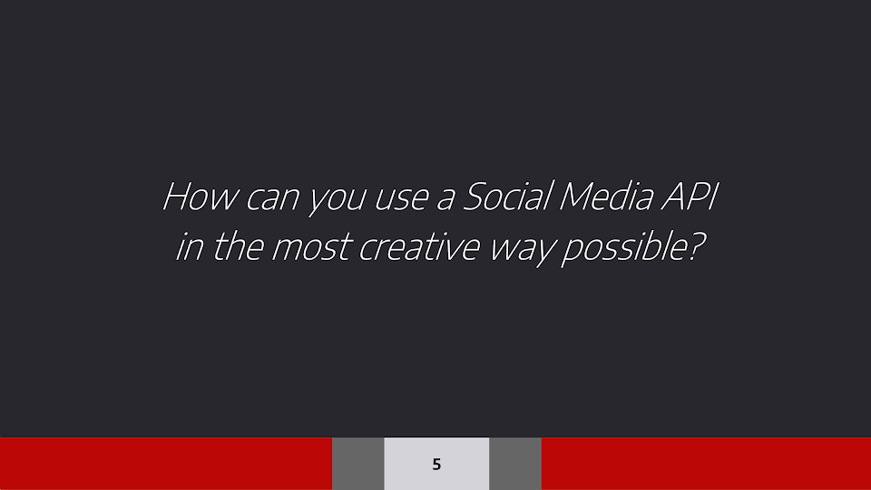

Slide 35
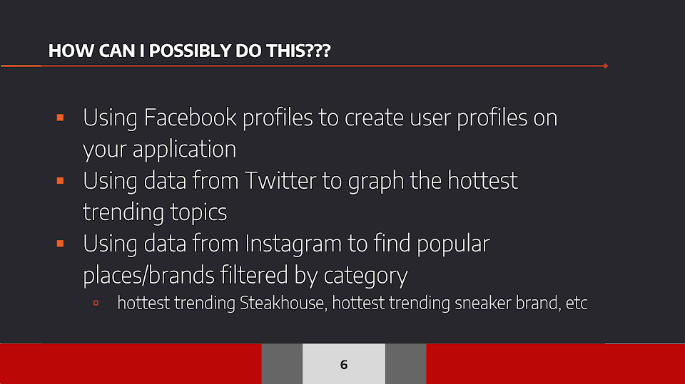

Slide 36
MLH Information
Major League Hacking Presentation

Slide 37
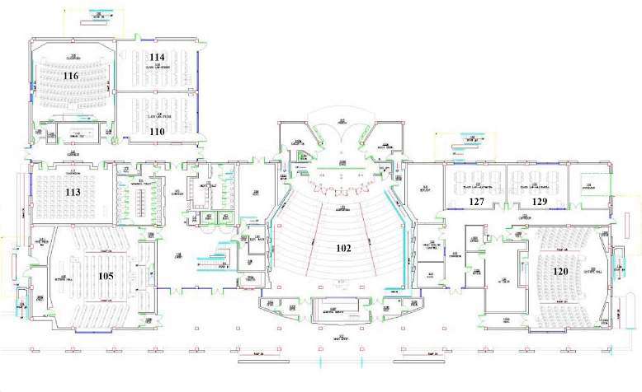
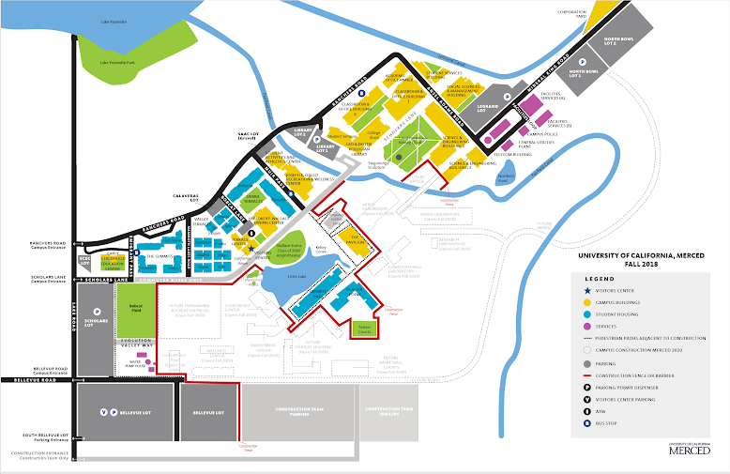
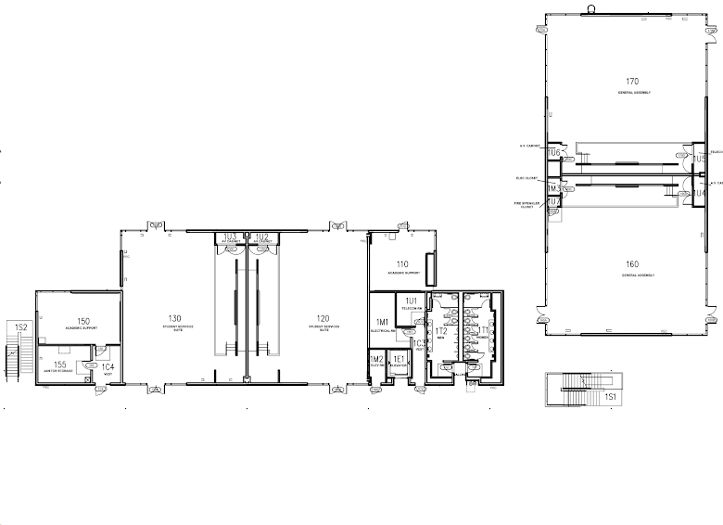
MAP HERE
Hacking Space
Closing Ceremony
Hacking Space
Smash Tourney
Hacking Space
Sleep /
Events
Food
Event Space
Notes:
…
Smash tourney on Saturday. Which brings me to my final thoughts

Slide 38
“I think that it’s extraordinarily important that we keep fun in computing.”
-Alan Perlis
first recipient of the Turing Award

Slide 39
Team Building &&
Networking Session
COB 102; 9pm - 10pm

Slide 40
For more info...
Check out live.hackmerced.io

